Slide 1
CasaGrande's Big Launch in Barcelona
The Battle of Neighborhoods
Capstone Project

Slide 2
Introduction
Barcelona is a city in Spain. It is the capital and largest city of the autonomous community of Catalonia, as well as the second most populous municipality of Spain.
With 8.3 million visitors in 2015, Barcelona is one of Europe’s most popular cities. Barcelona’s popularity has in fact been steadily increasing since 2010 (which saw 7.13 million visitors), and tourist numbers have more than doubled since 2000.

Slide 3
Introduction Cont..
1. Economy
The current state of the Spanish economy is a good indicator of the overall health of the Barcelona property market: loan defaults in Spanish banks are down, which indicates that Spanish people are earning more, meaning that the country’s economy is gaining momentum; this is backed by the country’s predicted GDP increase of 3.2%, which is one of the fastest increase rates in Europe.
2. Destination
Due to the city’s popularity as a holiday destination, luxury property is an especially profitable part of the Barcelona real estate market: as the 12th most visited city in the world, and among the top 5 most visited cities in Europe, Barcelona will likely always have a healthy interest from high-net-worth foreigners looking to buy or rent high-end properties in the city.
3.Infrastructure
Barcelona’s infrastructure should also be taken into consideration when thinking about investment. Transport and communication links in the city are exemplary, with high-functioning airports, high-speed rail networks, and busy trade ports bolstering the city’s economy.

Slide 4
Problem Statement and Target Audience
From all the fun facts, looks like Barcelona seems to be a great place to bloom the real estate business. CasaGrande is a real estate agency based out of Italy and it is looking to expand it horizon in Spain, starting with Bacelona which the 2nd largest city. Barcelona, the cosmopolitan capital of Spain’s Catalonia region, is known for its art and architecture.
For CasaGrande to be successful in Barcelona, it needs to analyse the neighborhood and find it's initial launch location. Thus the real estate company has decided to build out a data product and derive at conclusions to help them understand which areas would generate the most profit.

Slide 5
The Approach
CasaGrande has decided to identify the top 5 neighborhood in the city of Barcelona to ground break it's business. Further then it will use it's best successful advertising and campaign power to build its stable business and retain loyal customers.
For this the company will be leverage the machine learning techniques and data science to attain its goal which provides a great edge in supporting their decision in every step of the way

Slide 6
Data Description
1. GEONAMES.ORG
Geospatial and zipcode data was pulled from Geonames Geographical Database.
2. FourSquare
For this project we will use the knowledge acquired in course 9 to use the benefits of the Forsquare API to explore data from cities and neighborhoods, and data that is relevant for people who travel such as coffee shops, hotels, restaurants that can visit and be close, theaters and many places for which to have a choice.
3. National Institute of Statistics
We also will be using the data from http://www.ine.es/dynt3/inebase/index.htm?padre=525 which provides us with population data in each Munipality in Barcelona. This data will help us map the population in each neighborhood and which in return will help us understand a strong neighborhood community where real estate will bloom.

Slide 7


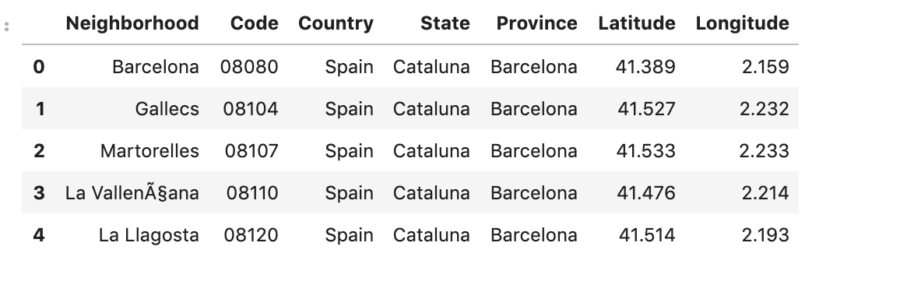
Methodology
1. Data Processing
Data was extracted from the above mentioned sources and successfully placed in a DataFrame for further processing. The data from Geonames that contains the latitude and longitude needed further extraction to be placed in their respective columns. The coordinates that are inserted in the form of rows were placed in new columns named as latitude and longitude. Duplicates data was removed. Data from with the population details did not require any transformation and hence fitted perfectly in line with the geonames data.

Slide 8
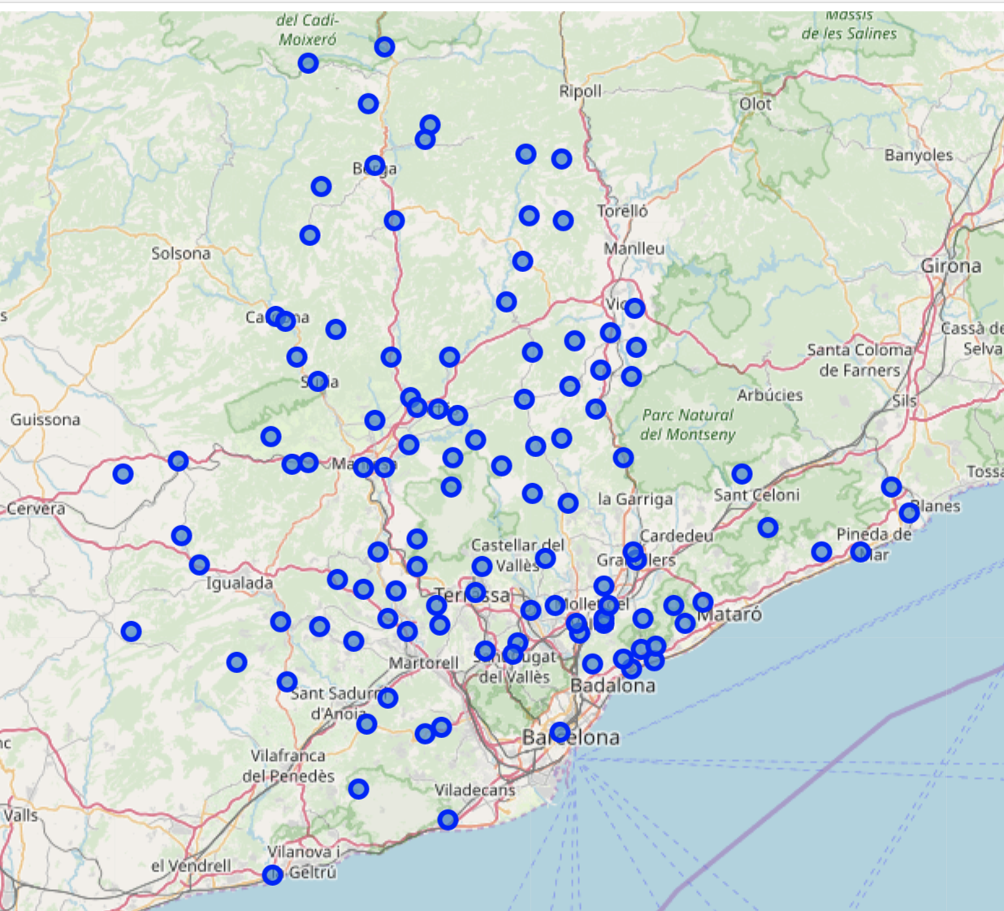
Methodology Cont ..
2.Exploring the Data
Using geopy library to getting the latitude and longitude values of Barcelona. Creating a map of Barcelona with neighborhoods superimposed on top show that there is a good spread of points across the county. This done using folium

Slide 9
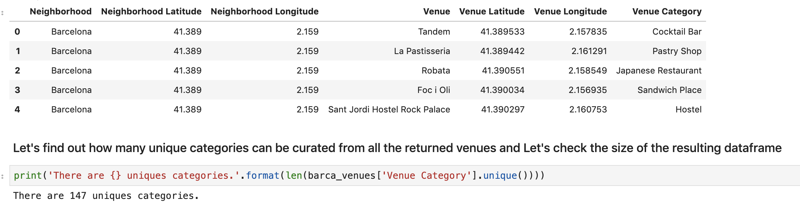
Methodology Cont ..
3.Analysing Neighborhoods in Barcelona
Lets use foursquare to let's get the top 100 venues that are in Barcelona within a radius of 500 meters and print each neighborhood along with the top 5 most common venues. In order to avoid overlapping, we decide to limit our search of businesses to 500 meters around each of these locations. We use the Foursquare API to create a dataframe of which includes, the business name, the type of business, and neighborhood in which it resides.

Slide 10
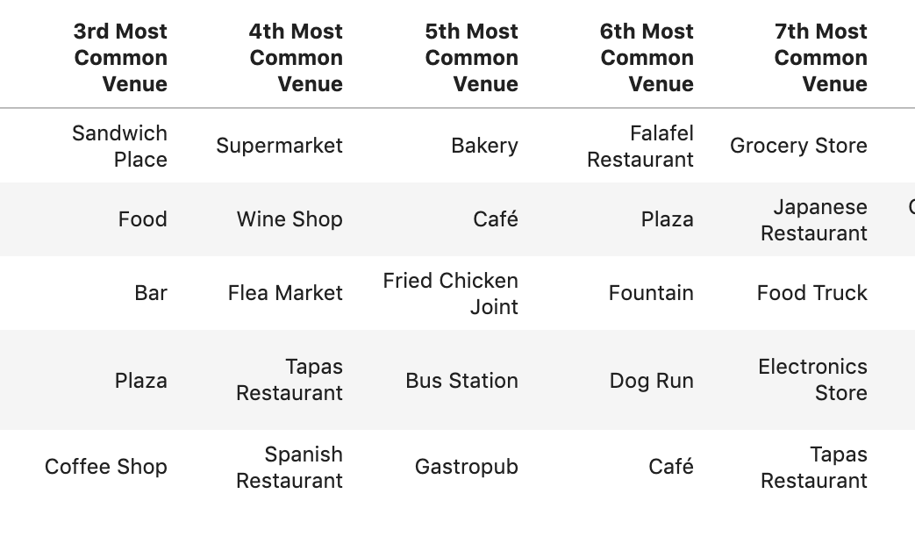
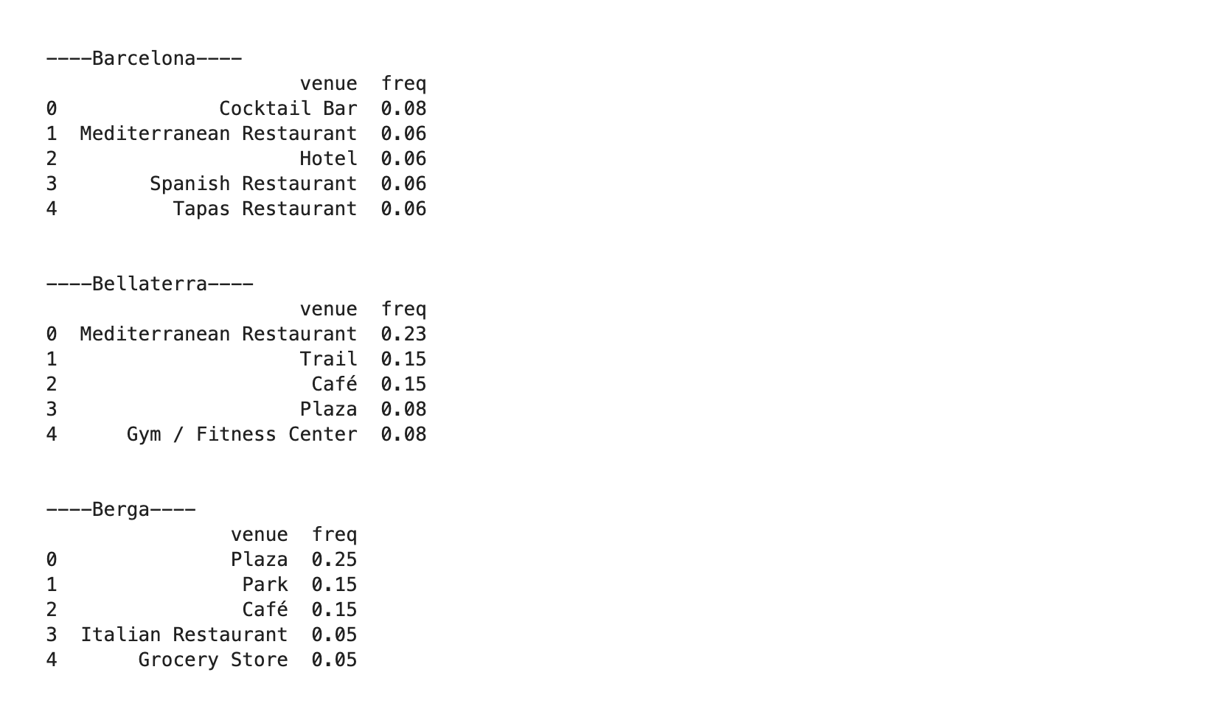
Cont..
Grouping the data by Neighbours and summarizing the data allows us to the see the frequency of most popular catogories of Venues.
Final step in this process would be to merge the data with Barcelona Data and render a new dataframe with top 10 venues for each neighborhood.This will serve as the input for K Means Clustering

Slide 11
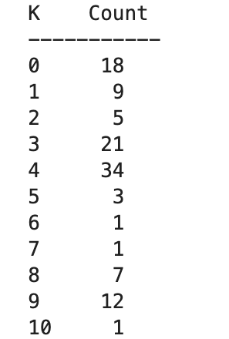
K-means Clustering
K-means Clustering Algorithm is applied to partition the final data frame into k(=10) partitions (clusters). The data was normalized using the MinMaxScaler from the sklearn library in Python and then fed to the KMeans cluster object to be fitted.We create another dataframe from this which shows the average amount of each business type per Neighborhood. Finally, we use the common types of businesses around each Neighborhood to put them into 10 clusters. In other words, each group contains Neighborhood with similar types of business.

Slide 12
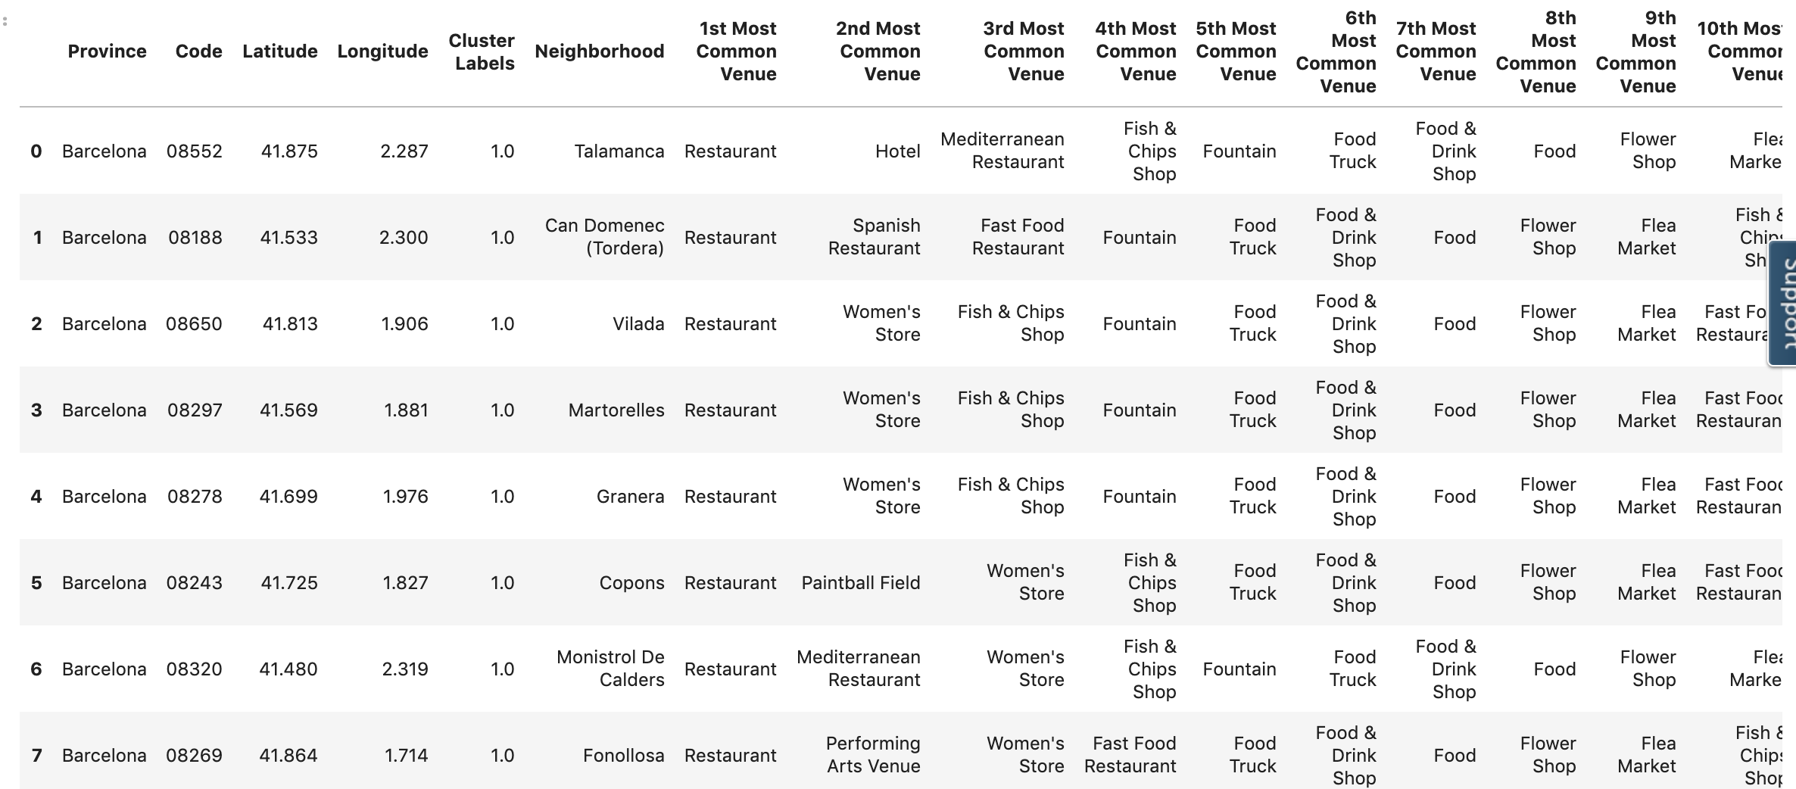


Slide 13
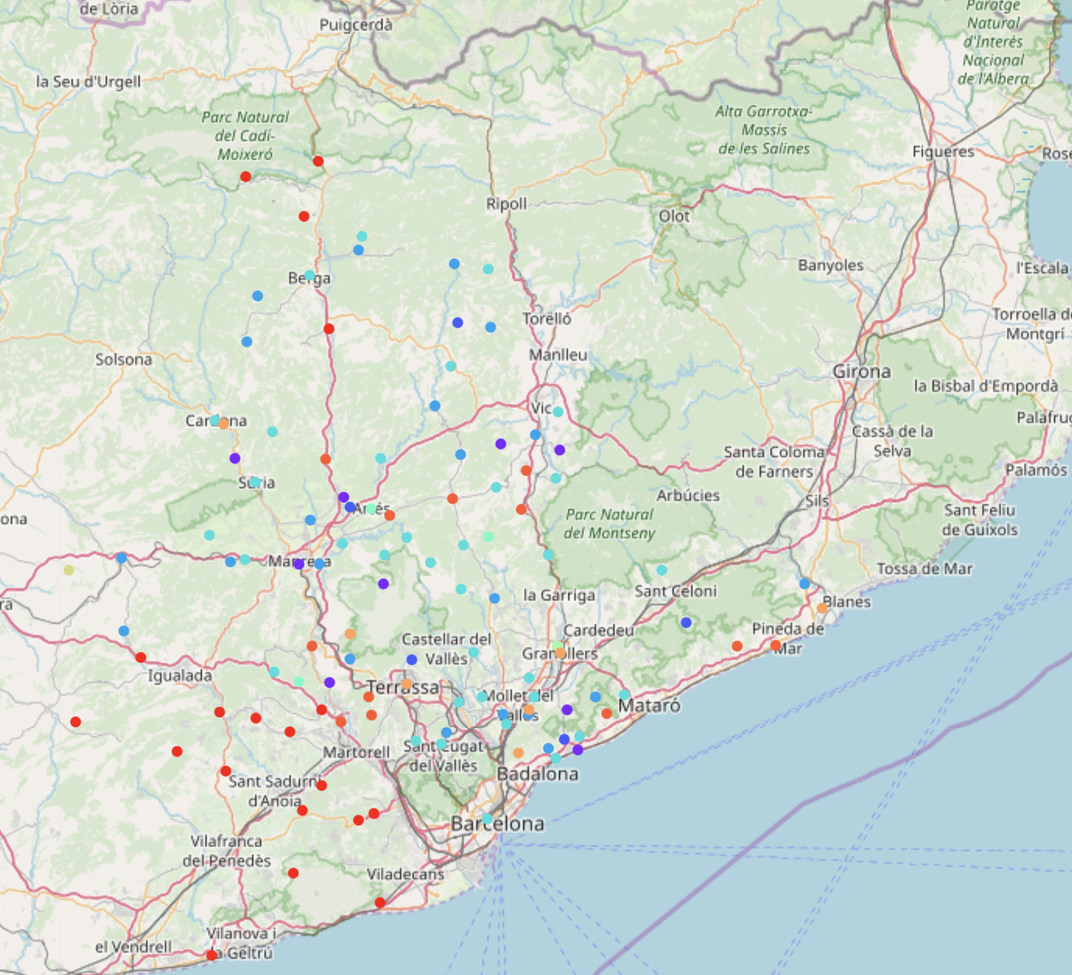
Clustering
For the final piece of visualization, I leveraged the folium package by inputting the necessary details like the desired number of clusters, Neighborhood, lat and long as shown below

Slide 14
Examine the Clusters- Results
All clusters have restaurants in common, we going to pick a few in particular and check the features associated
• Cluster 0 – Features : Restaurants, Women's store, Fountain, Flee Market
• Cluster 4 – Features : High population, Near by neighborhoods like restaurants, super market, movie theatres, soccer field, Rock climbing
• Cluster 8 – Features : 2nd Highest population, Bus station, Restaurants, Plaza, Flee Market
It is seen that Barcelona and Sandell fall under the same cluster while Badalona and Terrassa fall under the same cluster. And these take 1 - 4 position in terms of population as well.

Slide 15
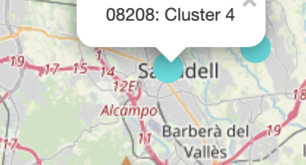
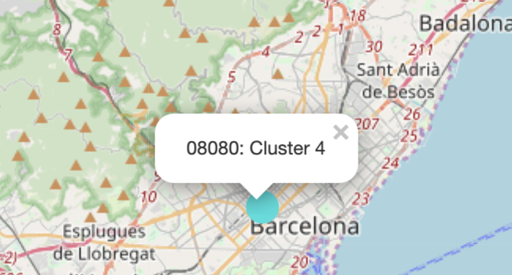
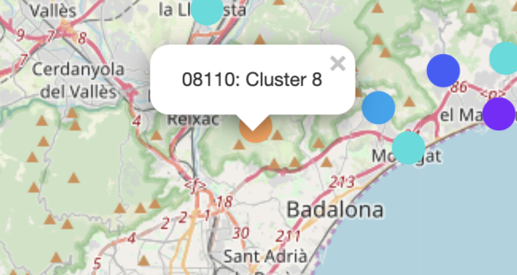
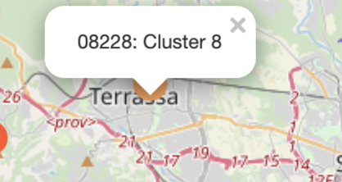

Slide 16
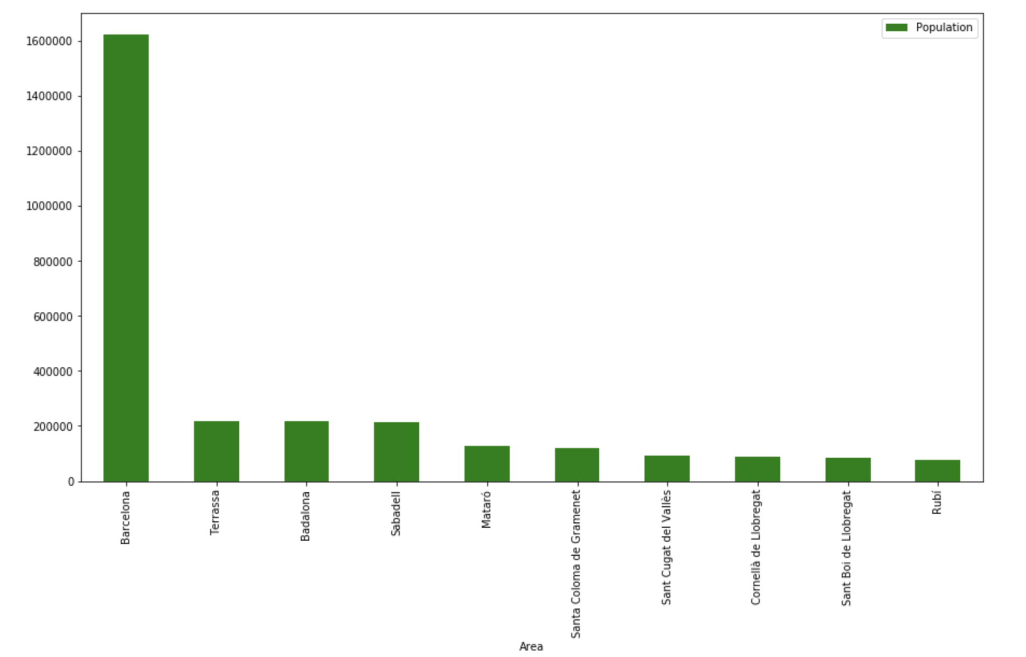
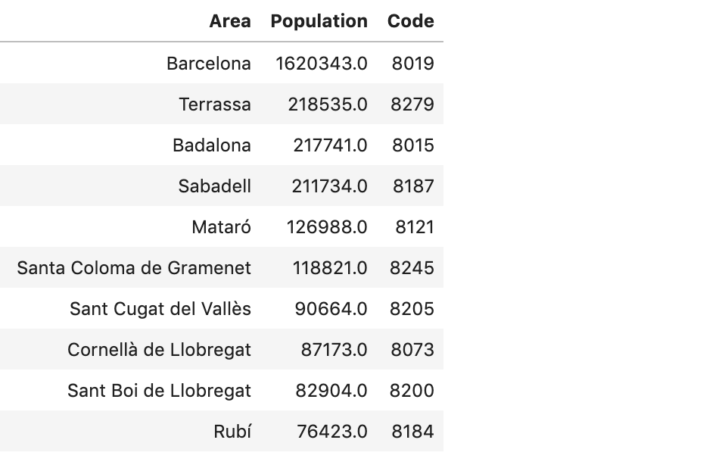
The Population Dataset
Exploring the population Dataset, its obvious that Barcelona city sweeps the floor with the highest population. Followed by Terrassa and Badalona. This gives us an edge in determining which place should be given a better priority.

Slide 17
Discussion
Barcelona is a very touristy place, it is seen that Cluster 8 has the highest population and almost all clusters includes restaurants. If CasaGrande would like to start a real estate business in Barcelona it should focus on areas like Barcelona City, Terrassa, Sandell, Badalona and Castelledefels. But we need to take into consideration other factors like schools, income statistics, safety before entering. Machine Learning is an ocean if we can get hold of the other important factoring data like education, income etc, we can perform better analysis and come to a better conclusion

Slide 18
Conclusion Cont..
However the company can start inversting in these location in the form of listing like airBnB or Hotels since looks like most of the population is floating and the venues are very touristy.
This data allows us to not only see the types of business around each neighborhood, but the larger areas in which those businesses are concentrated. Therefore we can determine the most beneficial places to advertise depending on our companies goals and in what way we should proceed in doing so.

